Slide 1
Data Mining:
Association

Slide 2
Mining Association Rules in Large Databases
Association rule mining
Mining single-dimensional Boolean association rules from transactional databases
Mining multilevel association rules from transactional databases
Mining multidimensional association rules from transactional databases and data warehouse
From association mining to correlation analysis
Constraint-based association mining
Summary

Slide 3
What Is Association Mining?
Association rule mining:
  Finding frequent patterns, associations, correlations, or causal structures among sets of items or objects in transaction databases, relational databases, and other information repositories.
Applications:
  Basket data analysis, cross-marketing, catalog design, loss-leader analysis, clustering, classification, etc.
Examples.
  Rule form: “Body → Ηead [support, confidence]”.
  buys(x, “diapers”) → buys(x, “beers”) [0.5%, 60%]
  major(x, “CS”) ^ takes(x, “DB”) → grade(x, “A”) [1%, 75%]

Slide 4
Association Rule: Basic Concepts
Given: (1) database of transactions, (2) each transaction is a list of items (purchased by a customer in a visit)
Find: all rules that correlate the presence of one set of items with that of another set of items
  E.g., 98% of people who purchase tires and auto accessories also get automotive services done
Applications
  Maintenance Agreement (What the store should do to boost Maintenance Agreement sales)
  Home Electronics (What other products should the store stocks up?)
  Attached mailing in direct marketing
  Detecting “ping-pong”ing of patients, faulty “collisions”

Slide 5
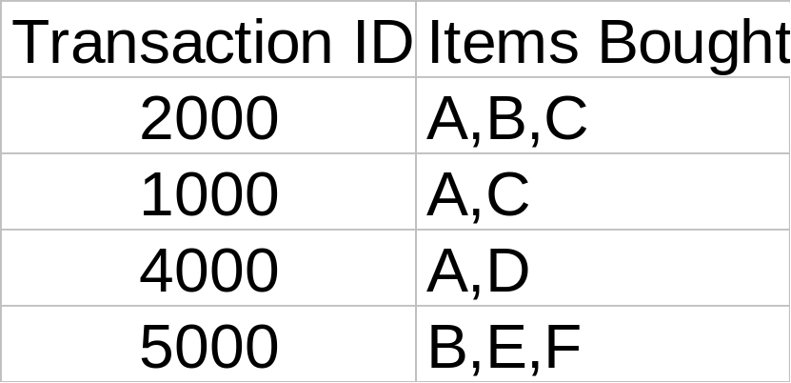
Rule Measures: Support and Confidence
Customer
buys both
Customer
buys diaper
Find all the rules X & Y ⇒ Z with minimum confidence and support
  support, s, probability that a transaction contains {X  Y  Z}
  confidence, c, conditional probability that a transaction having {X  Y} also contains Z
Customer
buys beer
Let minimum support 50%, and minimum confidence 50%, we have
  A ⇒ C (50%, 66.6%)
  C ⇒ A (50%, 100%)

Slide 6
Association Rule Mining: A Road Map
Boolean vs. quantitative associations (Based on the types of values handled)
  buys(x, “SQLServer”) ^ buys(x, “DMBook”) → buys(x, “DBMiner”) [0.2%, 60%]
  age(x, “30..39”) ^ income(x, “42..48K”) → buys(x, “PC”) [1%, 75%]
Single dimension vs. multiple dimensional associations
Single level vs. multiple-level analysis
  What brands of beers are associated with what brands of diapers?

Slide 7
Mining Association Rules in Large Databases
Association rule mining
Mining single-dimensional Boolean association rules from transactional databases
Mining multilevel association rules from transactional databases
Mining multidimensional association rules from transactional databases and data warehouse
From association mining to correlation analysis
Constraint-based association mining
Summary

Slide 8
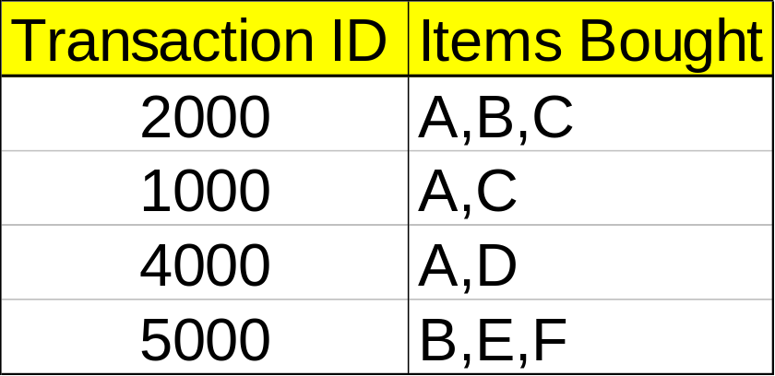
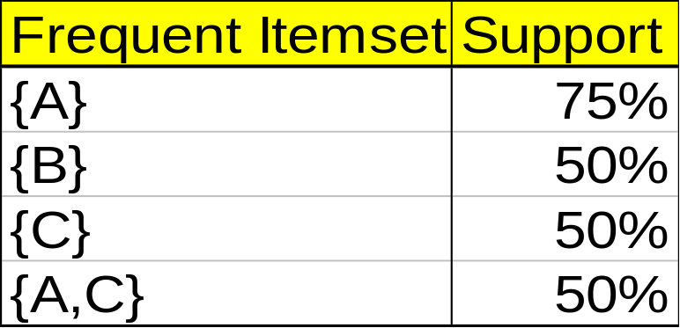
Mining Association Rules—An Example
Min. support 50%
Min. confidence 50%
For rule A ⇒ C:
  support = support({A C}) = 50%
  confidence = support({A C})/support({A}) = 66.6%
The Apriori principle:
  Any subset of a frequent itemset must be frequent

Slide 9
Mining Frequent Itemsets: the Key Step
Find the frequent itemsets: the sets of items that have minimum support
  A subset of a frequent itemset must also be a frequent itemset
    i.e., if {AB} is a frequent itemset, both {A} and {B} should be a frequent itemset
  Iteratively find frequent itemsets with cardinality from 1 to k (k-itemset)
Use the frequent itemsets to generate association rules.

Slide 10
The Apriori Algorithm
Join Step: C_{k} is generated by joining L_{k-1}with itself
Prune Step: Any (k-1)-itemset that is not frequent cannot be a subset of a frequent k-itemset
Pseudo-code:
    C_{k}: Candidate itemset of size k
    L_{k} : frequent itemset of size k
    L₁ = {frequent items};
    for (k = 1; L_{k} !=∅; k++) do begin
    C_{k+1} = candidates generated from L_{k};
    for each transaction t in database do
      increment the count of all candidates in C_{k+1} that are contained in t
    L_{k+1} = candidates in C_{k+1} with min_support
    end
    return ∪_{k} L_{k};

Slide 11








The Apriori Algorithm — Example
Database D
L₁
C₁
Scan D
C₂
C₂
L₂
Scan D
C₃
Scan D
L₃

Slide 12

Visualization of Association Rule Using Plane Graph

Slide 13
Mining Association Rules in Large Databases
Association rule mining
Mining single-dimensional Boolean association rules from transactional databases
Mining multilevel association rules from transactional databases
Mining multidimensional association rules from transactional databases and data warehouse
From association mining to correlation analysis
Constraint-based association mining
Summary

Slide 14
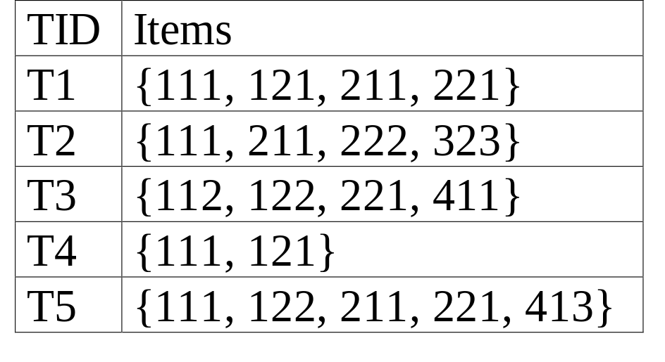
Multiple-Level Association Rules
Food
Items often form hierarchy.
Items at the lower level are expected to have lower support.
Rules regarding itemsets at
appropriate levels could be quite useful.
Transaction database can be encoded based on dimensions and levels
We can explore shared multi-level mining
milk
bread
skim
2%
wheat
white
Fraser
Sunset

Slide 15
Mining Multi-Level Associations
A top_down, progressive deepening approach:
  First find high-level strong rules:
milk → bread [20%, 60%].
  Then find their lower-level “weaker” rules:
2% milk → wheat bread [6%, 50%].
Variations at mining multiple-level association rules.
  Level-crossed association rules:
2% milk → Wonder wheat bread
  Association rules with multiple, alternative hierarchies:
2% milk → Wonder bread

Slide 16
Multi-level Association: Uniform Support vs. Reduced Support
Uniform Support: the same minimum support for all levels
  + One minimum support threshold. No need to examine itemsets containing any item whose ancestors do not have minimum support.
  – Lower level items do not occur as frequently. If support threshold
    too high ⇒ miss low level associations
    too low ⇒ generate too many high level associations
Reduced Support: reduced minimum support at lower levels
  There are 4 search strategies:
    Level-by-level independent
    Level-cross filtering by k-itemset
    Level-cross filtering by single item
    Controlled level-cross filtering by single item

Slide 17
Uniform Support
Multi-level mining with uniform support
Level 1
min_sup = 5%
Milk
[support = 10%]
Level 2
min_sup = 5%
2% Milk
[support = 6%]
Skim Milk
[support = 4%]
Back

Slide 18
Reduced Support
Multi-level mining with reduced support
Level 1
min_sup = 5%
Milk
[support = 10%]
Level 2
min_sup = 3%
2% Milk
[support = 6%]
Skim Milk
[support = 4%]
Back

Slide 19
Multi-level Association: Redundancy Filtering
Some rules may be redundant due to “ancestor” relationships between items.
Example
  milk ⇒ wheat bread [support = 8%, confidence = 70%]
  2% milk ⇒ wheat bread [support = 2%, confidence = 72%]
We say the first rule is an ancestor of the second rule.
A rule is redundant if its support is close to the “expected” value, based on the rule’s ancestor.

Slide 20
Multi-Level Mining: Progressive Deepening
A top-down, progressive deepening approach:
  First mine high-level frequent items:
milk (15%), bread (10%)
  Then mine their lower-level “weaker” frequent itemsets:
2% milk (5%), wheat bread (4%)
Different min_support threshold across multi-levels lead to different algorithms:
  If adopting the same min_support across multi-levels
    then toss t if any of t’s ancestors is infrequent.
  If adopting reduced min_support at lower levels
    then examine only those descendents whose ancestor’s support is frequent/non-negligible.

Slide 21
Progressive Refinement of Data Mining Quality
Why progressive refinement?
  Mining operator can be expensive or cheap, fine or rough
  Trade speed with quality: step-by-step refinement.
Superset coverage property:
  Preserve all the positive answers—allow a positive false test but not a false negative test.
Two- or multi-step mining:
  First apply rough/cheap operator (superset coverage)
  Then apply expensive algorithm on a substantially reduced candidate set (Koperski & Han, SSD’95).

Slide 22
Mining Association Rules in Large Databases
Association rule mining
Mining single-dimensional Boolean association rules from transactional databases
Mining multilevel association rules from transactional databases
Mining multidimensional association rules from transactional databases and data warehouse
From association mining to correlation analysis
Constraint-based association mining
Summary

Slide 23
Multi-Dimensional Association: Concepts
Single-dimensional rules:
    buys(X, “milk”) ⇒ buys(X, “bread”)
Multi-dimensional rules:  2 dimensions or predicates
  Inter-dimension association rules (no repeated predicates)
    age(X,”19-25”) ∧ occupation(X,“student”) ⇒ buys(X,“coke”)
  hybrid-dimension association rules (repeated predicates)
    age(X,”19-25”) ∧ buys(X, “popcorn”) ⇒ buys(X, “coke”)
Categorical Attributes
  finite number of possible values, no ordering among values
Quantitative Attributes
  numeric, implicit ordering among values

Slide 24
Mining Association Rules in Large Databases
Association rule mining
Mining single-dimensional Boolean association rules from transactional databases
Mining multilevel association rules from transactional databases
Mining multidimensional association rules from transactional databases and data warehouse
From association mining to correlation analysis
Constraint-based association mining
Summary

Slide 25
Interestingness Measurements
Objective measures
  Two popular measurements:
  support; and
  confidence
Subjective measures (Silberschatz & Tuzhilin, KDD95)
  A rule (pattern) is interesting if
  it is unexpected (surprising to the user); and/or
  actionable (the user can do something with it)

Slide 26
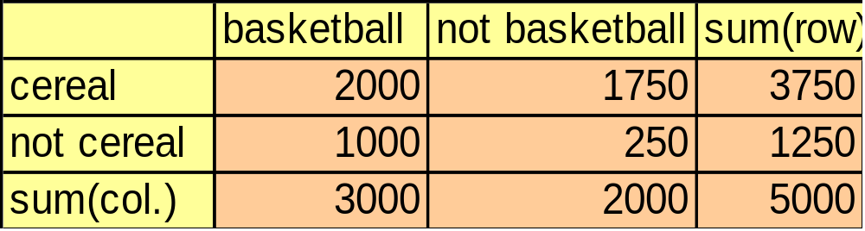
Criticism to Support and Confidence
Example 1: (Aggarwal & Yu, PODS98)
  Among 5000 students
    3000 play basketball
    3750 eat cereal
    2000 both play basket ball and eat cereal
  play basketball ⇒ eat cereal [40%, 66.7%] is misleading because the overall percentage of students eating cereal is 75% which is higher than 66.7%.
  play basketball ⇒ not eat cereal [20%, 33.3%] is far more accurate, although with lower support and confidence

Slide 27
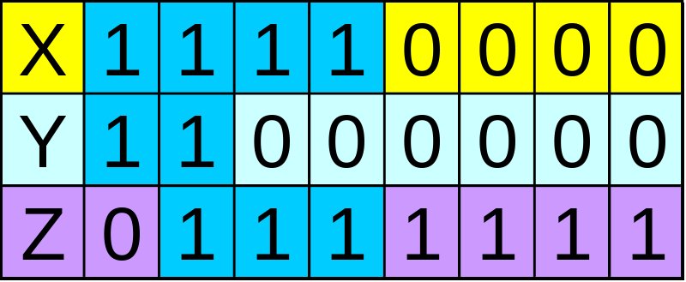
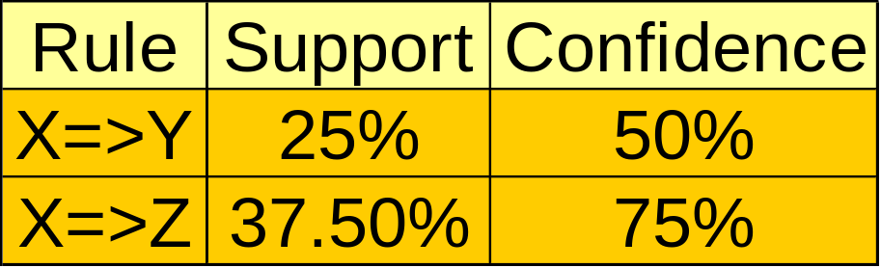
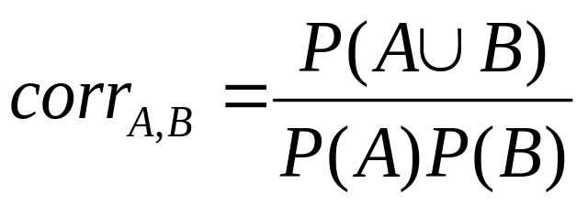
Criticism to Support and Confidence (Cont.)
Example 2:
  X and Y: positively correlated,
  X and Z, negatively related
  support and confidence of
  X=>Z dominates
We need a measure of dependent or correlated events
P(B|A)/P(B) is also called the lift of rule A => B

Slide 28
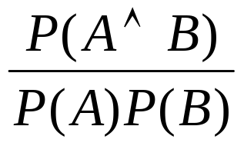
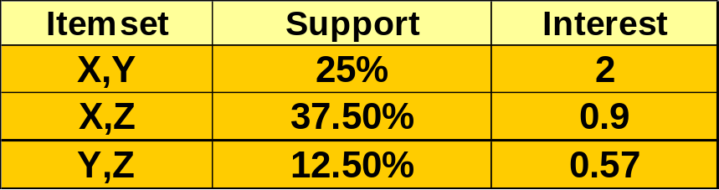
Other Interestingness Measures: Interest
Interest (correlation, lift)
  taking both P(A) and P(B) in consideration
  P(A^B)=P(B)*P(A), if A and B are independent events
  A and B negatively correlated, if the value is less than 1; otherwise A and B positively correlated

Slide 29
Mining Association Rules in Large Databases
Association rule mining
Mining single-dimensional Boolean association rules from transactional databases
Mining multilevel association rules from transactional databases
Mining multidimensional association rules from transactional databases and data warehouse
From association mining to correlation analysis
Constraint-based association mining
Summary

Slide 30
Constraint-Based Mining
Interactive, exploratory mining giga-bytes of data?
  Could it be real? — Making good use of constraints!
What kinds of constraints can be used in mining?
  Knowledge type constraint: classification, association, etc.
  Data constraint: SQL-like queries
    Find product pairs sold together in Vancouver in Dec.’98.
  Dimension/level constraints:
    in relevance to region, price, brand, customer category.
  Rule constraints
    small sales (price < $10) triggers big sales (sum > $200).
  Interestingness constraints:
    strong rules (min_support ≥ 3%, min_confidence ≥ 60%).

Slide 31
Mining Association Rules in Large Databases
Association rule mining
Mining single-dimensional Boolean association rules from transactional databases
Mining multilevel association rules from transactional databases
Mining multidimensional association rules from transactional databases and data warehouse
From association mining to correlation analysis
Constraint-based association mining
Summary

Slide 32
Summary
Association rule mining
  probably the most significant contribution from the database community in KDD
  A large number of papers have been published
Many interesting issues have been explored
An interesting research direction
  Association analysis in other types of data: spatial data, multimedia data, time series data, etc.

Slide 33
References
R. Agarwal, C. Aggarwal, and V. V. V. Prasad. A tree projection algorithm for generation of frequent itemsets. In Journal of Parallel and Distributed Computing (Special Issue on High Performance Data Mining), 2000.
R. Agrawal, T. Imielinski, and A. Swami. Mining association rules between sets of items in large databases. SIGMOD'93, 207-216, Washington, D.C.
R. Agrawal and R. Srikant. Fast algorithms for mining association rules. VLDB'94 487-499, Santiago, Chile.
R. Agrawal and R. Srikant. Mining sequential patterns. ICDE'95, 3-14, Taipei, Taiwan.
R. J. Bayardo. Efficiently mining long patterns from databases. SIGMOD'98, 85-93, Seattle, Washington.
S. Brin, R. Motwani, and C. Silverstein. Beyond market basket: Generalizing association rules to correlations. SIGMOD'97, 265-276, Tucson, Arizona.
S. Brin, R. Motwani, J. D. Ullman, and S. Tsur. Dynamic itemset counting and implication rules for market basket analysis. SIGMOD'97, 255-264, Tucson, Arizona, May 1997.
K. Beyer and R. Ramakrishnan. Bottom-up computation of sparse and iceberg cubes. SIGMOD'99, 359-370, Philadelphia, PA, June 1999.
D.W. Cheung, J. Han, V. Ng, and C.Y. Wong. Maintenance of discovered association rules in large databases: An incremental updating technique. ICDE'96, 106-114, New Orleans, LA.
M. Fang, N. Shivakumar, H. Garcia-Molina, R. Motwani, and J. D. Ullman. Computing iceberg queries efficiently. VLDB'98, 299-310, New York, NY, Aug. 1998.

Slide 34
References (2)
G. Grahne, L. Lakshmanan, and X. Wang. Efficient mining of constrained correlated sets. ICDE'00, 512-521, San Diego, CA, Feb. 2000.
Y. Fu and J. Han. Meta-rule-guided mining of association rules in relational databases. KDOOD'95, 39-46, Singapore, Dec. 1995.
T. Fukuda, Y. Morimoto, S. Morishita, and T. Tokuyama. Data mining using two-dimensional optimized association rules: Scheme, algorithms, and visualization. SIGMOD'96, 13-23, Montreal, Canada.
E.-H. Han, G. Karypis, and V. Kumar. Scalable parallel data mining for association rules. SIGMOD'97, 277-288, Tucson, Arizona.
J. Han, G. Dong, and Y. Yin. Efficient mining of partial periodic patterns in time series database. ICDE'99, Sydney, Australia.
J. Han and Y. Fu. Discovery of multiple-level association rules from large databases. VLDB'95, 420-431, Zurich, Switzerland.
J. Han, J. Pei, and Y. Yin. Mining frequent patterns without candidate generation. SIGMOD'00, 1-12, Dallas, TX, May 2000.
T. Imielinski and H. Mannila. A database perspective on knowledge discovery. Communications of ACM, 39:58-64, 1996.
M. Kamber, J. Han, and J. Y. Chiang. Metarule-guided mining of multi-dimensional association rules using data cubes. KDD'97, 207-210, Newport Beach, California.
M. Klemettinen, H. Mannila, P. Ronkainen, H. Toivonen, and A.I. Verkamo. Finding interesting rules from large sets of discovered association rules. CIKM'94, 401-408, Gaithersburg, Maryland.

Slide 35
References (3)
F. Korn, A. Labrinidis, Y. Kotidis, and C. Faloutsos. Ratio rules: A new paradigm for fast, quantifiable data mining. VLDB'98, 582-593, New York, NY.
B. Lent, A. Swami, and J. Widom. Clustering association rules. ICDE'97, 220-231, Birmingham, England.
H. Lu, J. Han, and L. Feng. Stock movement and n-dimensional inter-transaction association rules. SIGMOD Workshop on Research Issues on Data Mining and Knowledge Discovery (DMKD'98), 12:1-12:7, Seattle, Washington.
H. Mannila, H. Toivonen, and A. I. Verkamo. Efficient algorithms for discovering association rules. KDD'94, 181-192, Seattle, WA, July 1994.
H. Mannila, H Toivonen, and A. I. Verkamo. Discovery of frequent episodes in event sequences. Data Mining and Knowledge Discovery, 1:259-289, 1997.
R. Meo, G. Psaila, and S. Ceri. A new SQL-like operator for mining association rules. VLDB'96, 122-133, Bombay, India.
R.J. Miller and Y. Yang. Association rules over interval data. SIGMOD'97, 452-461, Tucson, Arizona.
R. Ng, L. V. S. Lakshmanan, J. Han, and A. Pang. Exploratory mining and pruning optimizations of constrained associations rules. SIGMOD'98, 13-24, Seattle, Washington.
N. Pasquier, Y. Bastide, R. Taouil, and L. Lakhal. Discovering frequent closed itemsets for association rules. ICDT'99, 398-416, Jerusalem, Israel, Jan. 1999.

Slide 36
References (4)
J.S. Park, M.S. Chen, and P.S. Yu. An effective hash-based algorithm for mining association rules. SIGMOD'95, 175-186, San Jose, CA, May 1995.
J. Pei, J. Han, and R. Mao. CLOSET: An Efficient Algorithm for Mining Frequent Closed Itemsets. DMKD'00, Dallas, TX, 11-20, May 2000.
J. Pei and J. Han. Can We Push More Constraints into Frequent Pattern Mining? KDD'00. Boston, MA. Aug. 2000.
G. Piatetsky-Shapiro. Discovery, analysis, and presentation of strong rules. In G. Piatetsky-Shapiro and W. J. Frawley, editors, Knowledge Discovery in Databases, 229-238. AAAI/MIT Press, 1991.
B. Ozden, S. Ramaswamy, and A. Silberschatz. Cyclic association rules. ICDE'98, 412-421, Orlando, FL.
J.S. Park, M.S. Chen, and P.S. Yu. An effective hash-based algorithm for mining association rules. SIGMOD'95, 175-186, San Jose, CA.
S. Ramaswamy, S. Mahajan, and A. Silberschatz. On the discovery of interesting patterns in association rules. VLDB'98, 368-379, New York, NY..
S. Sarawagi, S. Thomas, and R. Agrawal. Integrating association rule mining with relational database systems: Alternatives and implications. SIGMOD'98, 343-354, Seattle, WA.
A. Savasere, E. Omiecinski, and S. Navathe. An efficient algorithm for mining association rules in large databases. VLDB'95, 432-443, Zurich, Switzerland.
A. Savasere, E. Omiecinski, and S. Navathe. Mining for strong negative associations in a large database of customer transactions. ICDE'98, 494-502, Orlando, FL, Feb. 1998.

Slide 37
References (5)
C. Silverstein, S. Brin, R. Motwani, and J. Ullman. Scalable techniques for mining causal structures. VLDB'98, 594-605, New York, NY.
R. Srikant and R. Agrawal. Mining generalized association rules. VLDB'95, 407-419, Zurich, Switzerland, Sept. 1995.
R. Srikant and R. Agrawal. Mining quantitative association rules in large relational tables. SIGMOD'96, 1-12, Montreal, Canada.
R. Srikant, Q. Vu, and R. Agrawal. Mining association rules with item constraints. KDD'97, 67-73, Newport Beach, California.
H. Toivonen. Sampling large databases for association rules. VLDB'96, 134-145, Bombay, India, Sept. 1996.
D. Tsur, J. D. Ullman, S. Abitboul, C. Clifton, R. Motwani, and S. Nestorov. Query flocks: A generalization of association-rule mining. SIGMOD'98, 1-12, Seattle, Washington.
K. Yoda, T. Fukuda, Y. Morimoto, S. Morishita, and T. Tokuyama. Computing optimized rectilinear regions for association rules. KDD'97, 96-103, Newport Beach, CA, Aug. 1997.
M. J. Zaki, S. Parthasarathy, M. Ogihara, and W. Li. Parallel algorithm for discovery of association rules. Data Mining and Knowledge Discovery, 1:343-374, 1997.
M. Zaki. Generating Non-Redundant Association Rules. KDD'00. Boston, MA. Aug. 2000.
O. R. Zaiane, J. Han, and H. Zhu. Mining Recurrent Items in Multimedia with Progressive Resolution Refinement. ICDE'00, 461-470, San Diego, CA, Feb. 2000.

